Slide 1
Spine surgery prediction using ml
TeElla Chaitanya Kumar
Dr.Ashwini nanda

Slide 2
Spine Surgery prediction
What is the input?
Data of various patients collected over various age and sex groups
What is the output?
To give the type of surgery(Posterior or Anterior) that needs to be done on the spine
Why should this problem be solved?
This problem can give immediate prediction of the surgery with less time and resources
How to approach?
We use Logistic Regression Machine learning model to predict the output

Slide 3
Data analysis
In the data provided there are various factors that involve in determining the type of surgery
Sex, Diagnosis, Main Pathology, Number of Levels, Various Scores etc…
We will analysis some information using various libraries of python like pandas, plotly, matplotlib.
Diagnosis vs Type of Surgery, Age vs Type of Surgery to get a sense of correlation between them

Slide 4
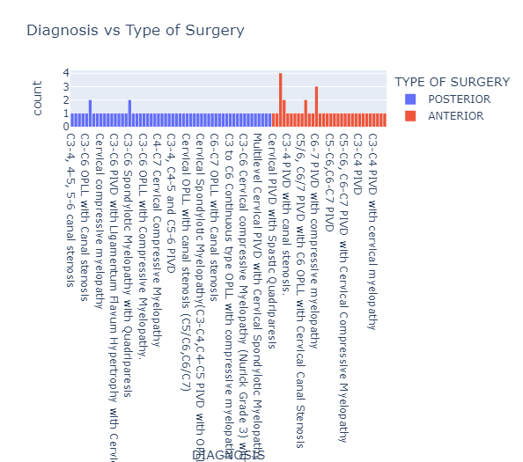
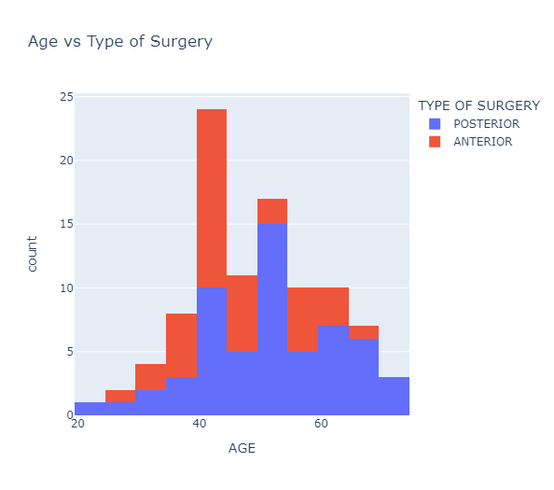
Analysis Graphs

Slide 5
Data Preprocessing
Observation
From the above analysis we can see that both numeric and categorical columns affecting the output
Libraries used
We will use scikit-learn library of python to split and preprocess the data
Logistic Regression
After preprocessing the input data we use LogisticRegression from scikit-learn to train for the output target column
To get proper workflow we will divide the given data to three parts training, validation, testing models
In input columns, numerical data is scaled evenly using MinMaxscaler, categorical data is encoded with OneHotEncoder
We will test the accuracy and confusion matrix for the training, validation, testing models

Slide 6
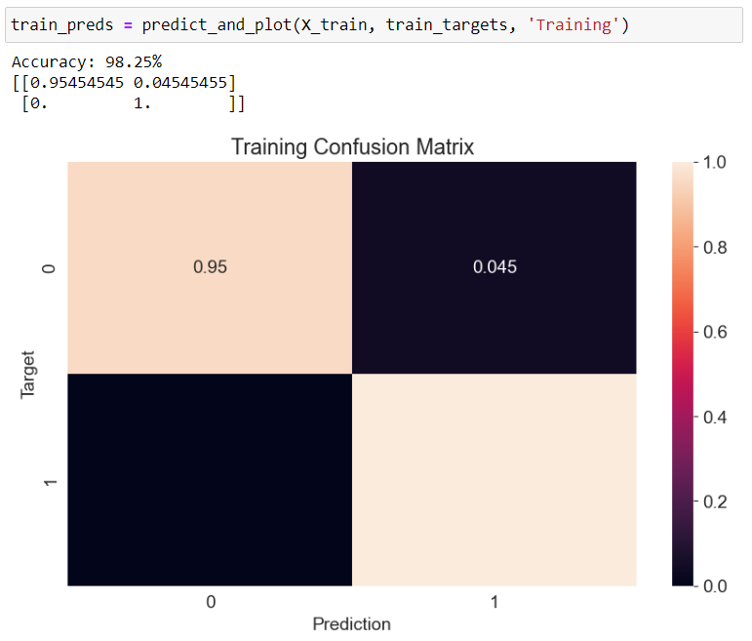
Training the model
After training the model with training input columns and target columns the model was finalized
Now I wrote a function to calculate the accuracy score and confusion matrix for the data

Slide 7
Accuracy and confusion matrix
Accuracy represents the how much accurately the model is predicting the target type (Posterior or Anterior)
Confusion matrix represents how each type is predicated either true or false with what probability
 | Anterior | Posterior
Anterior | True Probability | False Probability
Posterior | False Probability | True Probability

Slide 8
Testing
Now we test the other validation and testing models we divided to check and train for further optimization
Validation accuracy – 98.25%
Testing accuracy – 90.00%
We can check the confusion matrices for the same by rerunning the function we have defined
After retesting the model, we will run the model for the final results of the all input values

Slide 9
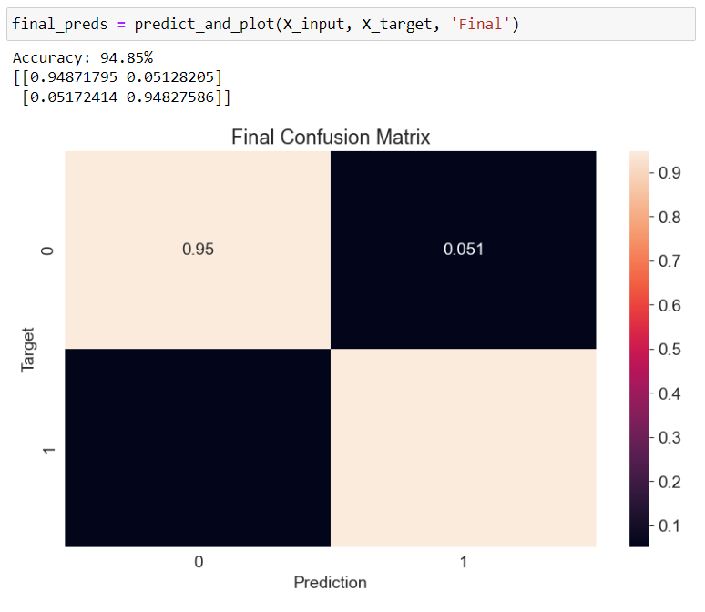
Final Result

